Slide 1
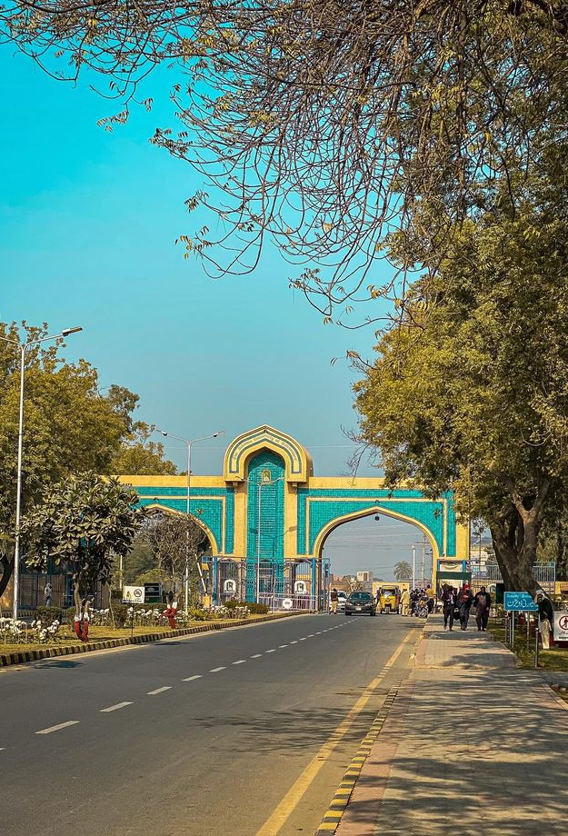
Project Presentation
Expense Tracker.
M. Saqib Zahid, Umair Mehboob, M. Junaid

Slide 2
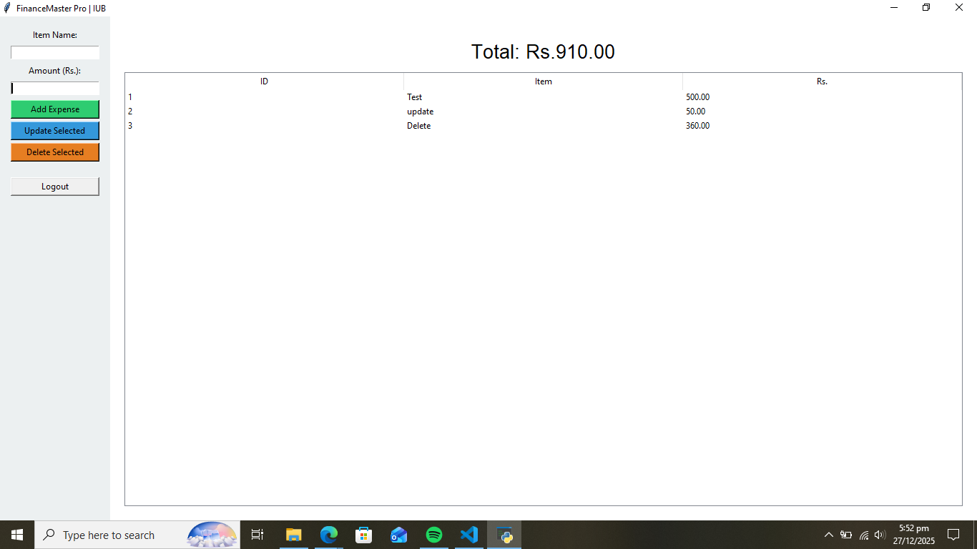
Bismillah-ir-Rahman-ir-Raheem
شُروع اَللہ کے پاک نام سے جو بڑا مہر بان نہایت رحم والا ہے

Slide 3
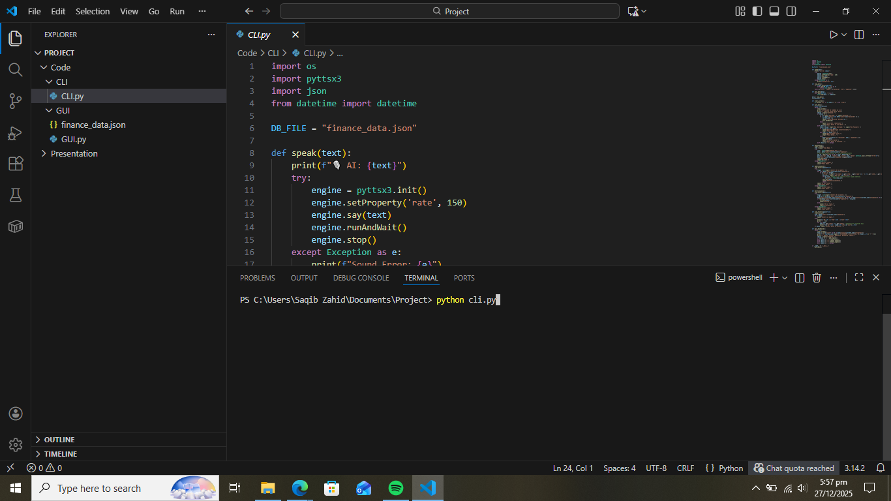
Expense Tracker
A python program that help users take control of their expenses.
The project uses, file handling, Built-in and external Modules, data persistency and supports multiple users.

Slide 4

The code uses four modules.
OS (Built-in)
Pyttsx3 (External)
Json(Built-in)
Datetime (Built-in)

Slide 5
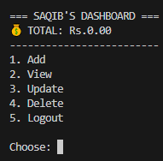
Features
The project uses CRUD operations.
Add (Create)
View (Read)
Update (Update)
Delete (Delete)

Slide 6
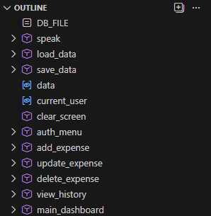
Code Outline
Uses Multiple Functions
DB_FILE to save data
speak (Uses pyttsx3 | External Module)
laod_data and save_data (Json)
clear_screen (OS | clear screen)
auth_menu (For Log-in and Sign-up)
add_expense, update_expense, delete_expense, view_history (For CRUD operations)
main_dashboard (For Main menu)

Slide 7
Vibe Coding
By using Gemini. We can convert a simple CLI program to a beautiful python application.

Slide 8
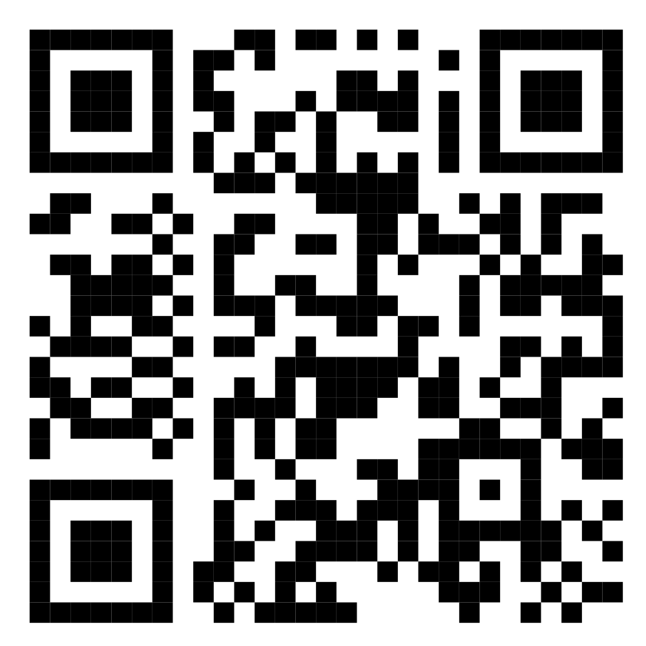
Thanks
Scan QR to access code
Any Question

